Slide 1
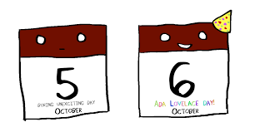
post
postcard
posture
postpone
postwar
postdate

Slide 2
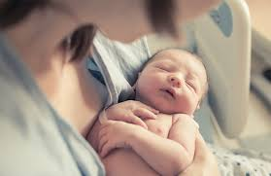
postscript
postnatal
posterity
posterior
postmodern
postmaster

Slide 3
post-operative
posthumous
postmortem
post-
haste
postponement
postgraduate

