Slide 1
session passion mission
permission submission admission

Slide 2
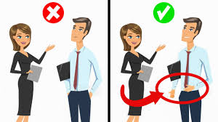
expression impression profession
aggression progression obsession

Slide 3
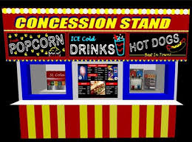
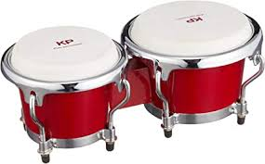
discussion depression succession
concession omission percussion

