Slide 1
nation creation operation
education relation location

Slide 2
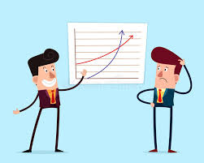
exploration explanation conversation
information quotation association

Slide 3
celebration investigation cancellation
identification pronunciation observation

