Slide 1
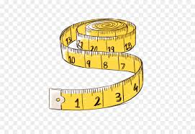
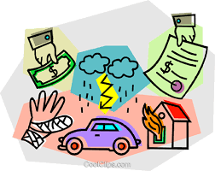
sure unsure ensure
assure measure insure

Slide 2
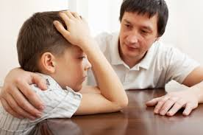
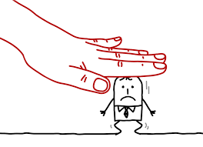
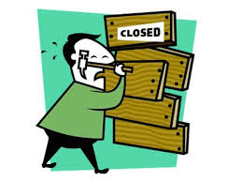
reassure pressure closure
censure fissure leisurely

Slide 3
composure enclosure overexposure
disclosure displeasure countermeasure

