Slide 1
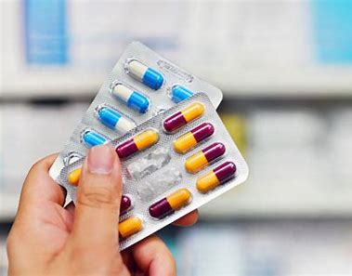
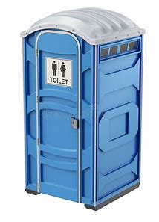
avoidable profitable available
portable adaptable dependable

Slide 2
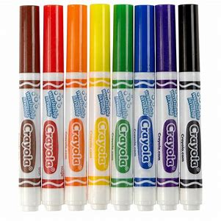
breakable usable lovable
irritable enjoyable debatable

Slide 3
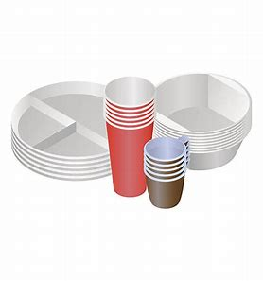
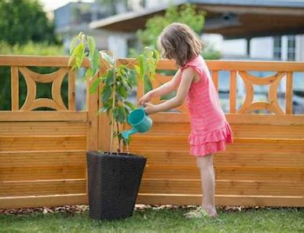
changeable disposable desirable
miserable variable noticeable

