Slide 1
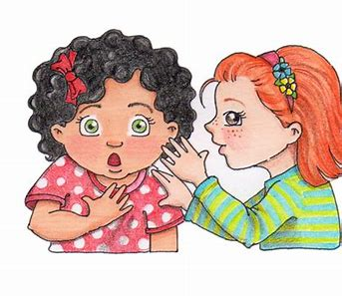
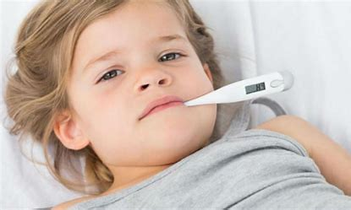
evil email secret
legal fever regal

Slide 2
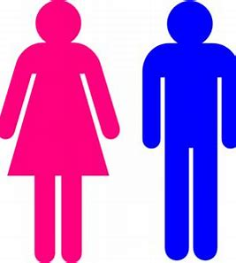
female prefect recent
media create medium

Slide 3
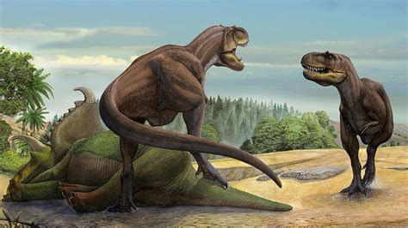
frequent adhesive medieval
chameleon immediate prehistoric

